Slide 1
Assignment 3

Slide 2
Agenda Style
01
Overview
02
Dataset
03
EDA Process:Excel & PowerBI
04
Power BI
05
Conclusion
06
References

Slide 3
Overview

Slide 4
Overview
Understanding the dataset
Research Questions
Which Year had the best prices?
Which Product prices has been consistently doing well?
Is there any pattern observed?
Which market has best prices?
Cleansing the dataset using EDA
OVERVIEW
Creation of New Data Set
Dashboard Creation
Loading the dataset in Power BI

Slide 5
Dataset

Slide 6
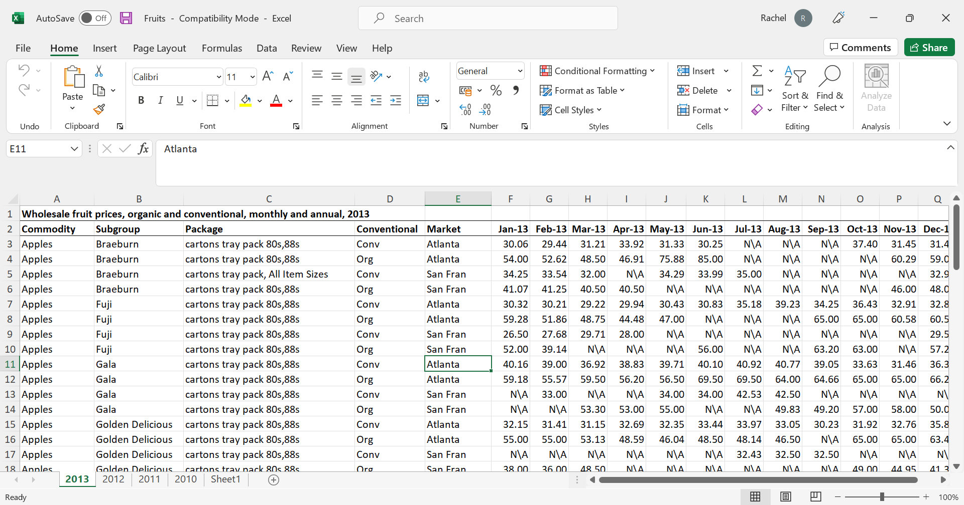
DATASET
Original dataset contains multiple sheets for different years
Column names are year and month combination.

Slide 7
EDA Process:
Excel & PowerBI

Slide 8
EDA Process
Creating uniformity in column names
Cleaning numeric and string fields
Merging Sheets
Adding Year column. Added Q1,Q2,Q3,Q4 columns for analysis

Slide 9
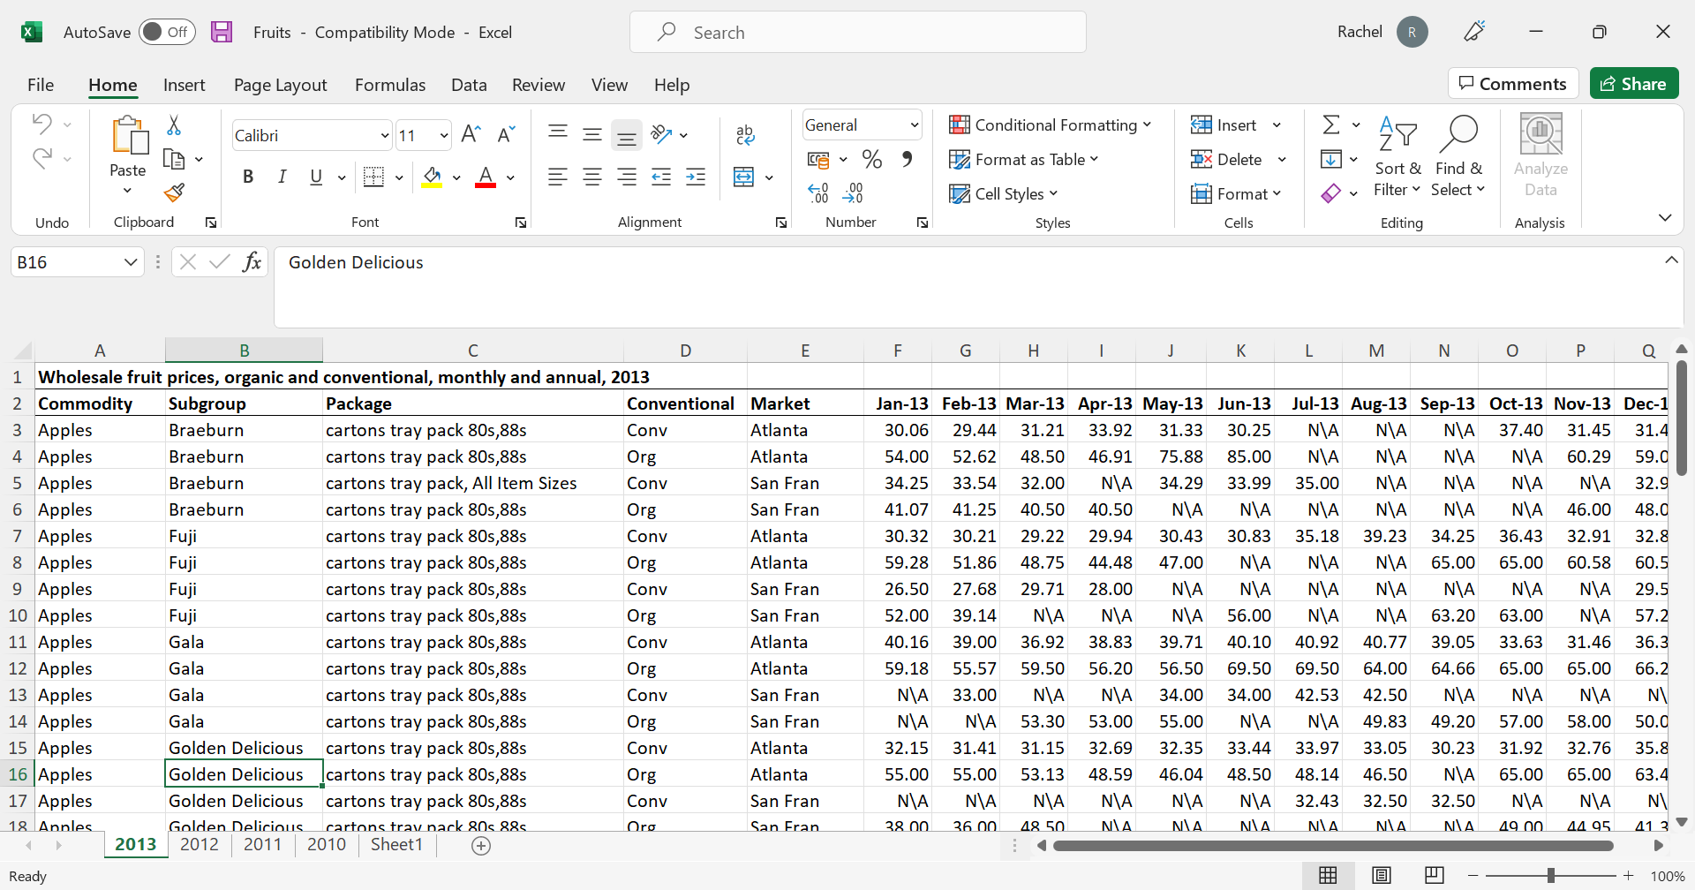
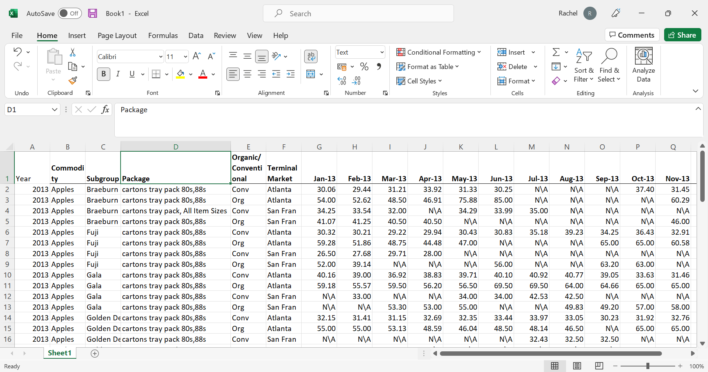
EDA Process
Original
Modified
Inserting New column year to identify for which year the data belongs to.

Slide 10
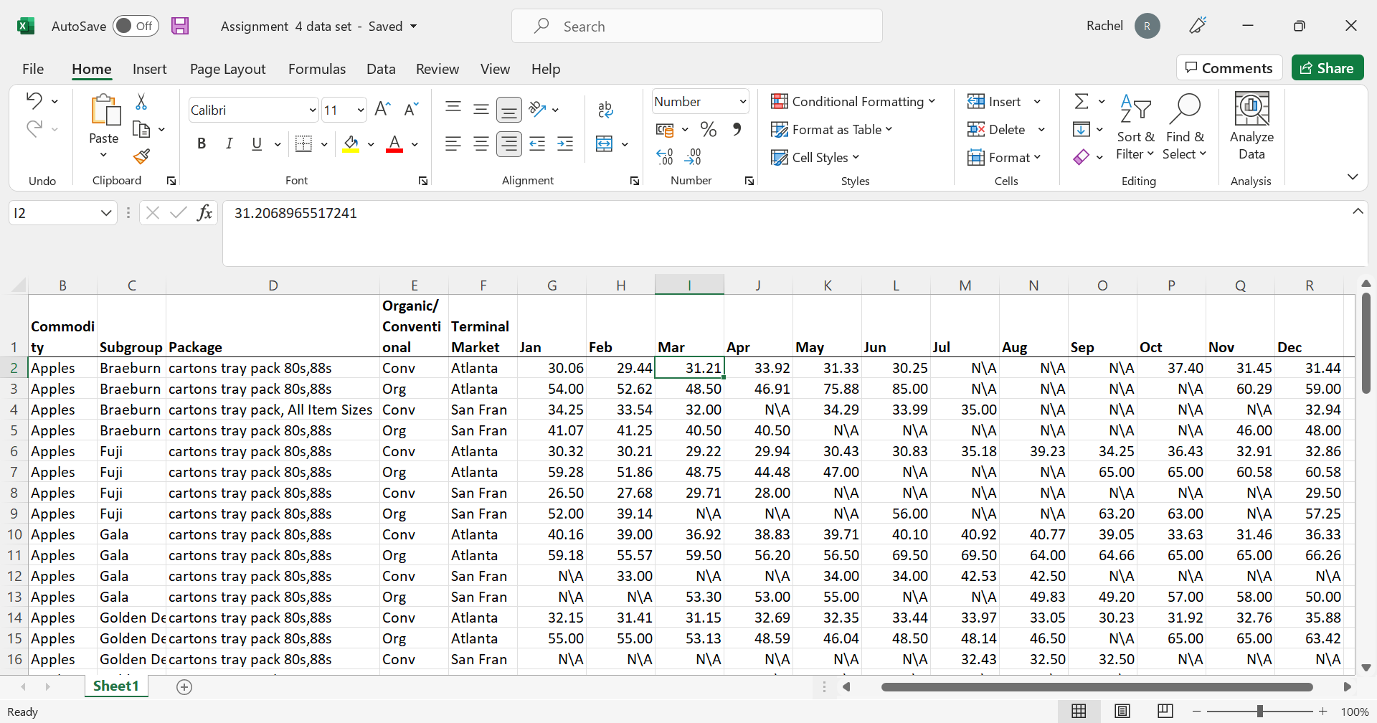
EDA Process
Original
Modified
Renaming the column names to unify across the dataset

Slide 11
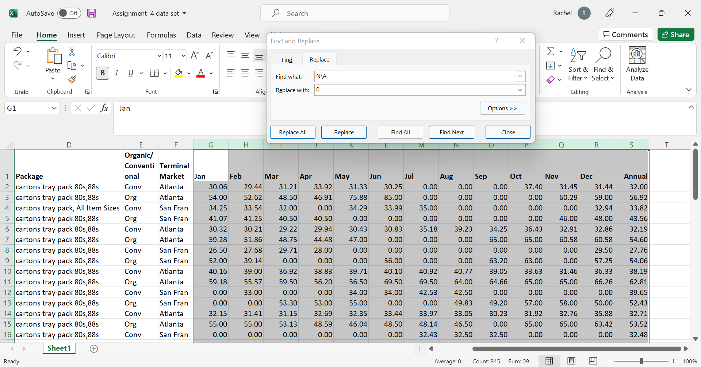
EDA Process
Original
Modified
Converting all the NA in the numeric columns to 0. Converting all the blanks in the non numeric fields to appropriate values that can be used for analysis.

Slide 12
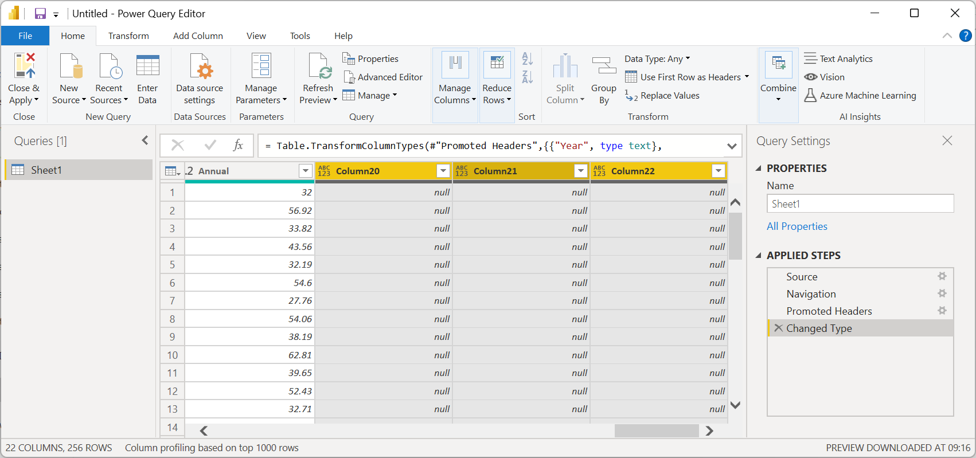
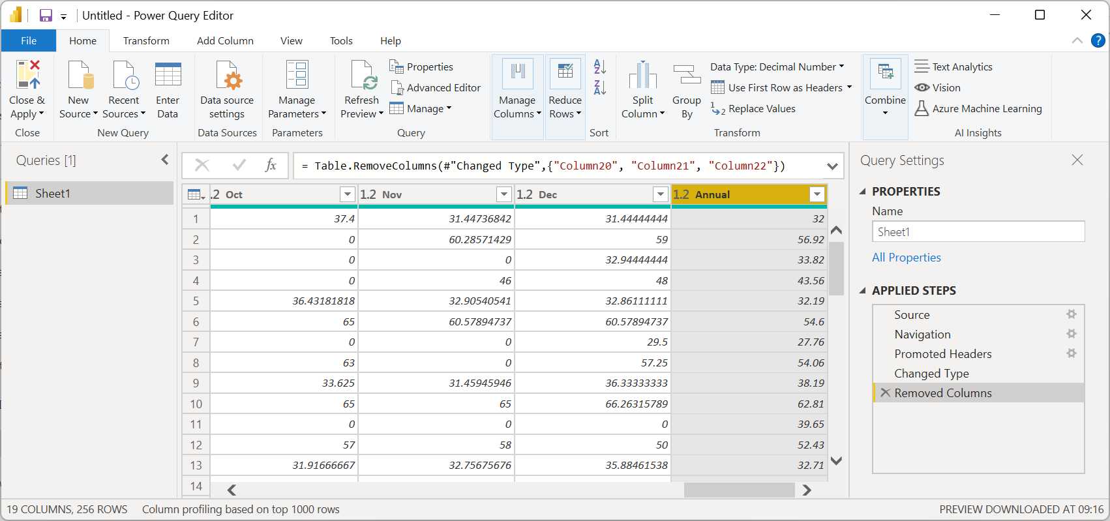
EDA Process
Original
Modified
Changed the datatype of Year to make it a text so that values don’t add up.
Deleting extra columns which are not required for analysis
.

Slide 13
Power BI

Slide 14
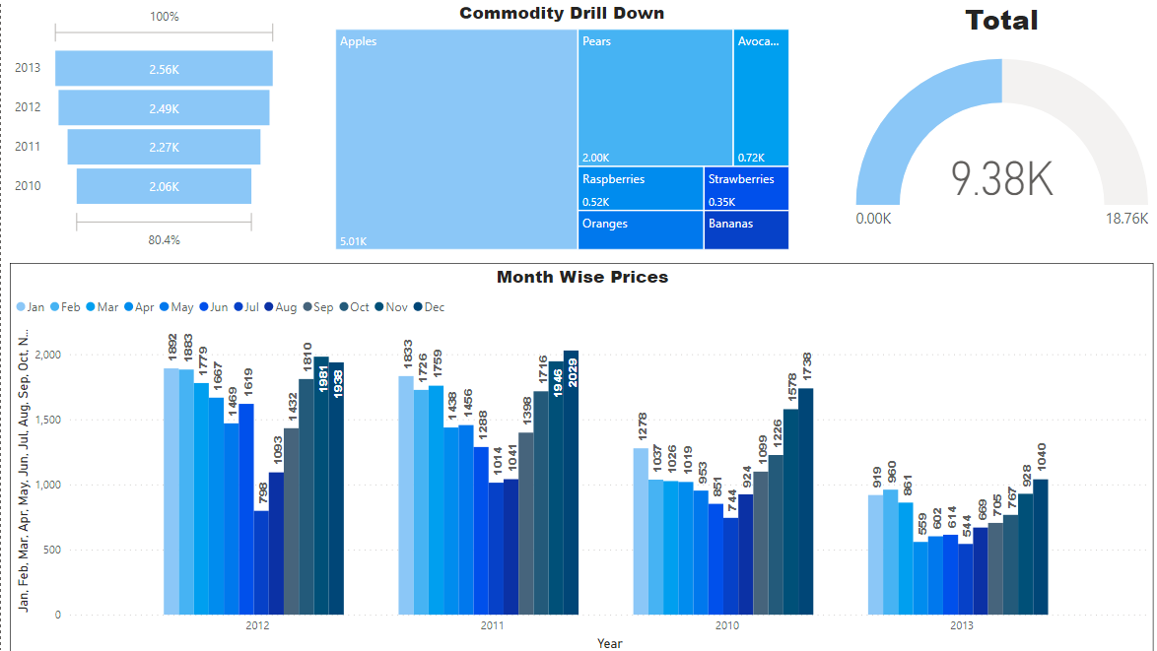
Dashboard
This dashboard shows the prices for the products on a yearly basis.
Monthly prices break up can be seen
The heat map shows a drill down of the each of the type of product that is available.
The year acts as a filter and the corresponding values change.

Slide 15
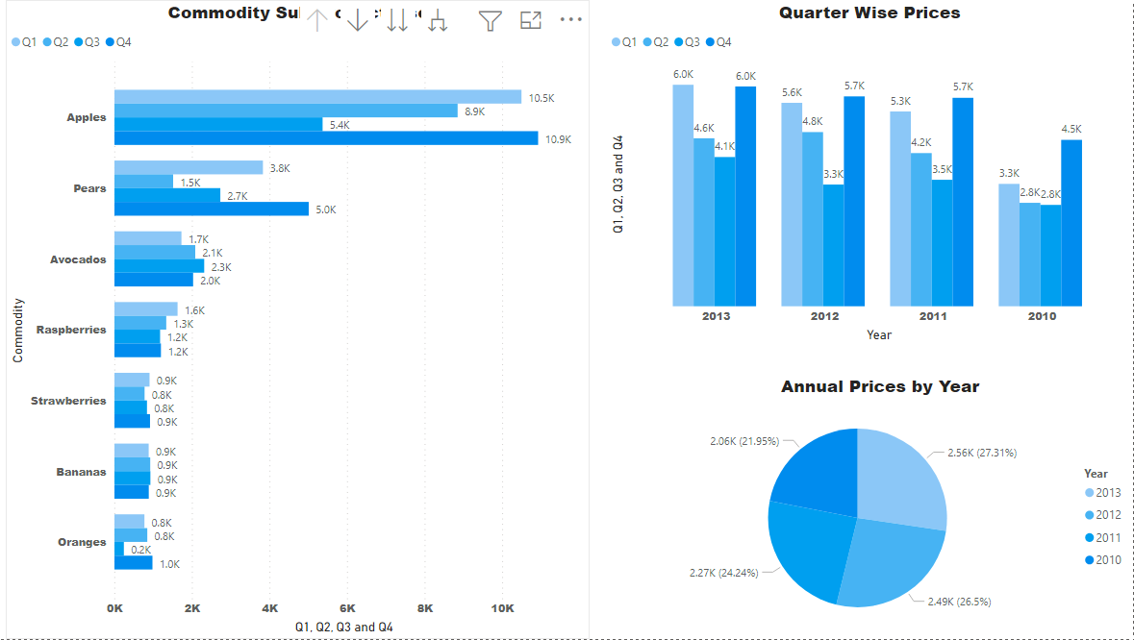
Dashboard
This dashboard shows quarter wise prices for the all the products.
Year wise bifurcation of organic and conventional type is visible.
Selecting any of these acts as a filter and corresponding values change.

Slide 16
Conclusion

Slide 17
Conclusion
As observed the prices are the highest in the year 2013 and are progressively increasing year on year in terms of the annual prices. Whereas if you compare the month on month sales Dec 2011 has the highest price.
San Francisco seems to be doing better than Atlanta in most of the cases.
Apples as a commodity fetch the highest price as compared to other commodities.
Q4 is consistently doing well across all the products and years

Slide 18
Reference

Slide 19
References
DATASET
https://www.ers.usda.gov/data-products/organic-prices.aspx
Youtube link
https://www.youtube.com/watch?v=YLlq1ZPRXtw

Slide 20
THANK YOU

